Slide 1
Jupiter Storms
Eric Cheng
Tuba Opel
Nancy Wen

Slide 2
Storm Detection

Slide 3
After a Gaussian Blur and a Hough Circle Detection

Slide 4
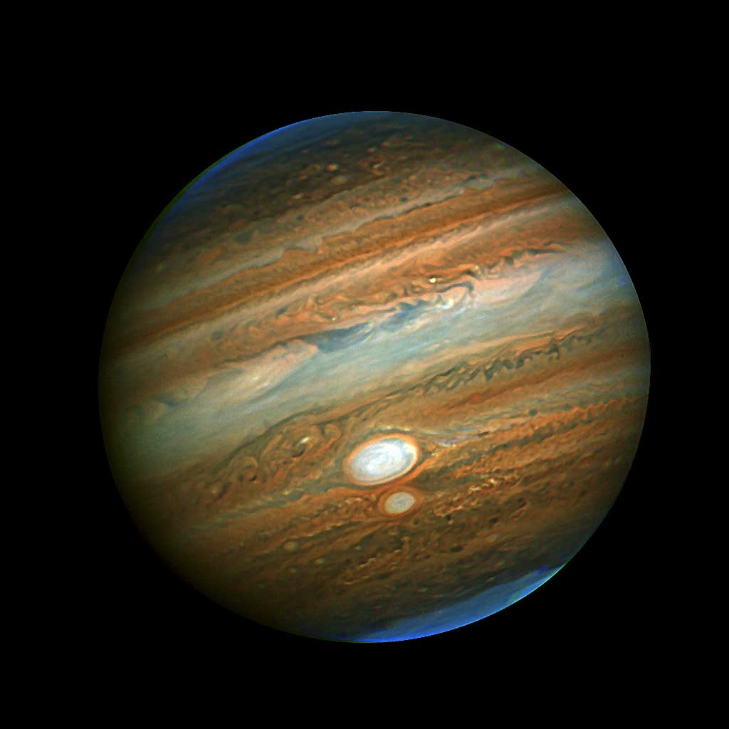
Collect Storm Metrics
The Great Red Spot:
Dimensions: 24-40,000 km x 12-14,000 km
Large enough to contain two or three Earths
Been around for 300 years

Slide 5
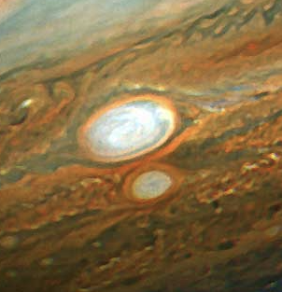
Inferring Size of Storm
(0, 0)
Red Spot Junior:
10-18,000 km x 5-6,000 km
Red Spot Junior is the roughly the size of earth (Diameter: 8000 km)
(525, 620)
(585, 625)
(550, 675)
(490, 670)
(555, 695)
(585, 700)
(540, 715)
(565, 720)

Slide 6
Next Steps
Open the JunoCam Raw Images
Optimize Storm Detection Algorithm
Aggregate detected circles’ data to throw out outliers
Replace Circle Detection with Ellipse Detection
Collect storm metrics relative to the Great Red Spot

Slide 7
THANK YOU!

